Slide 1

Exploring neighborhoods AROUND cAREY business school

Slide 2
Background
In 2019, Baltimore ranks the 4th most dangerous city in America, according to financial news website 247wallst.com. Baltimore’s violent crime rate in 2018, which was 1,833.4 per 100,000 people, is nearly five times higher than the national violent crime rate of 369 per 100,000 people. At the same time, properties some of the safest areas of Baltimore remained overly expensive for both buyers and renters. The disconnection between the housing market and the public not only arouses social uneasiness but also widens the economcic gap between working classes.

Slide 3
However, there is currently no accessible platform that would guide students attending JHU Carey Business School to choose which neighborhood to live in and make suggestion of which restaurants to go to. This project will give a brief introduction and offer some insights to the living environment of Inner Harbor, Baltimore, MD.

Slide 4
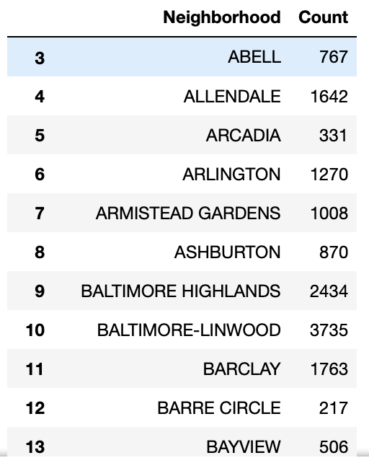
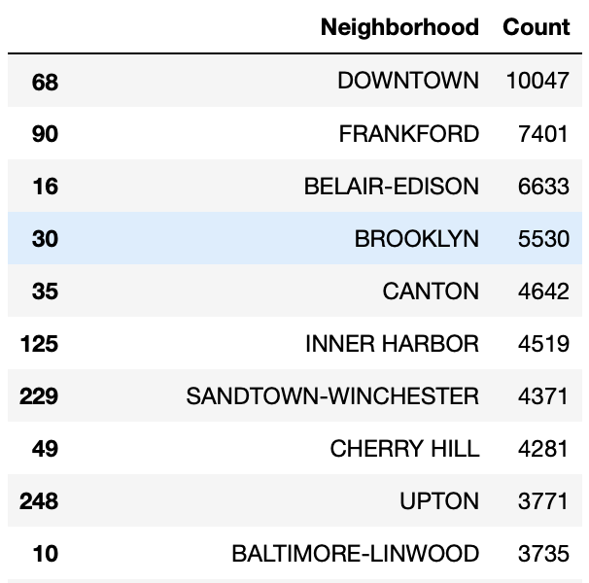
Extracting data and group by Different Neighborhoods then sort by descending order

Slide 5
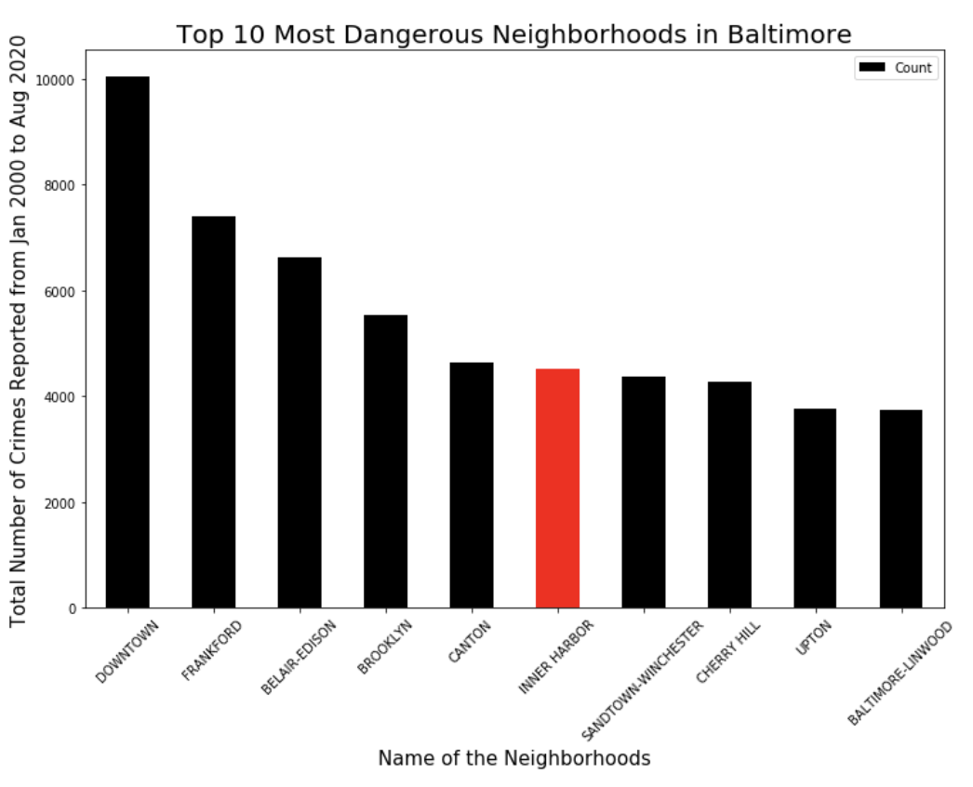
Plot the top 10 most dangerous neighborhoods with their number of crime cases. Inner Harbor ranked number six

Slide 6
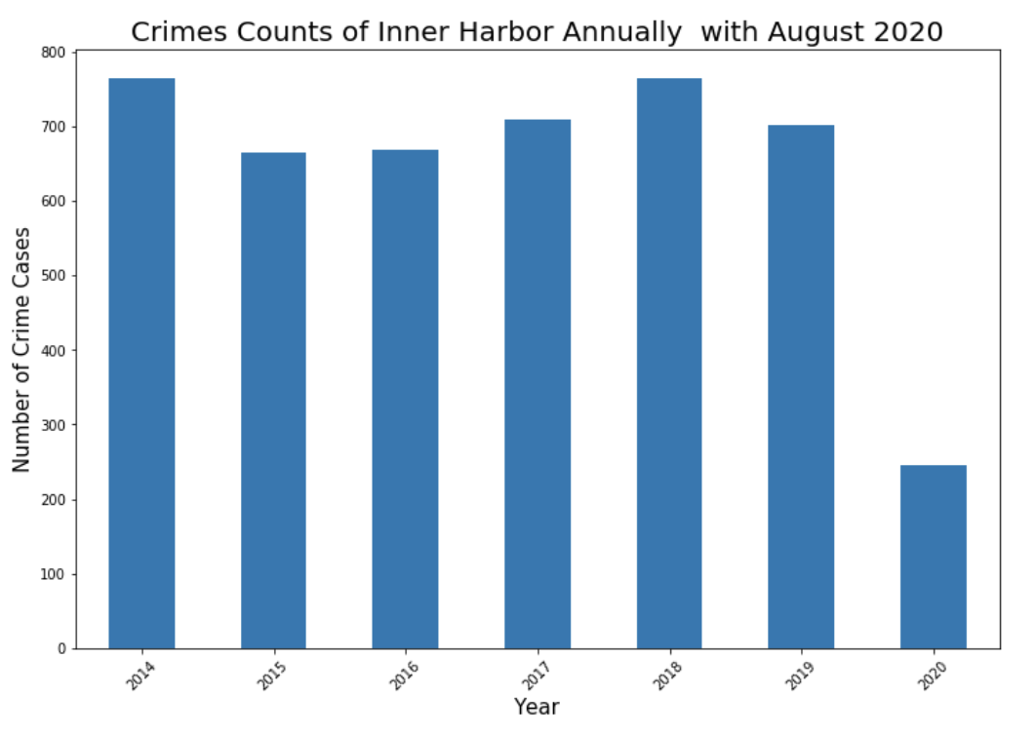
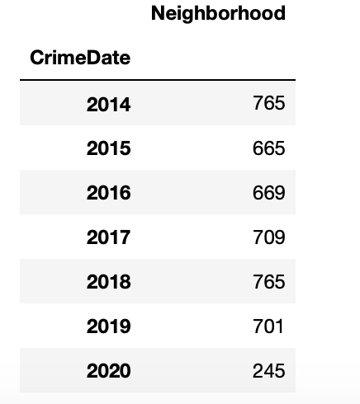
Looking specifically at Inner Harbor until August 2020, and plot number of cases annually

Slide 7
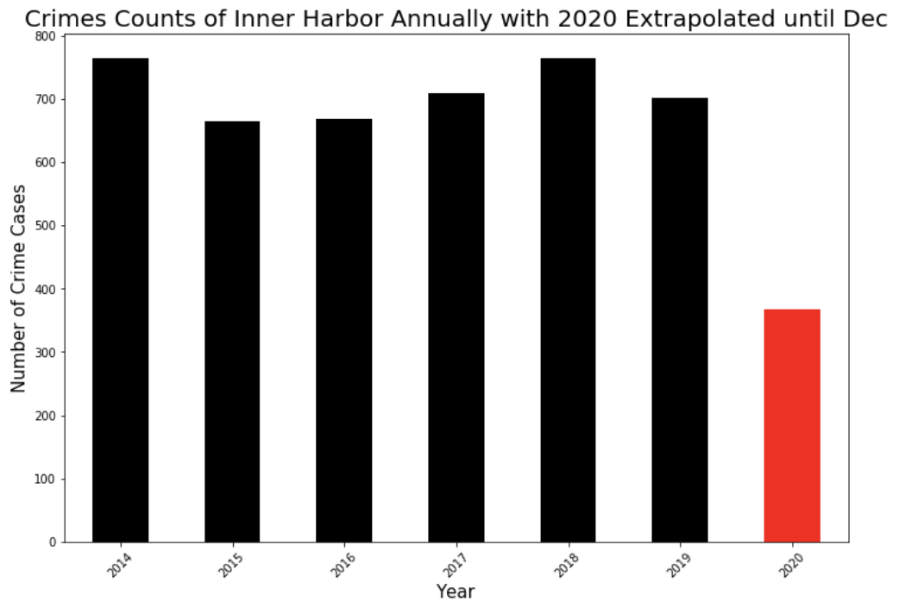
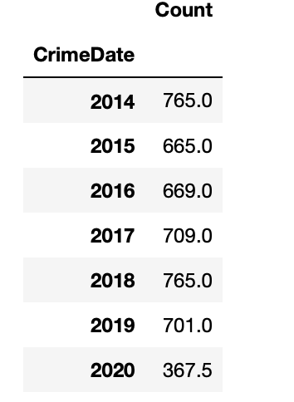
Extrapolate the number of cases to a full 2020 proportionally

Slide 8
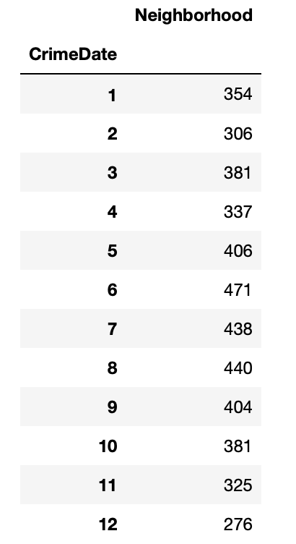
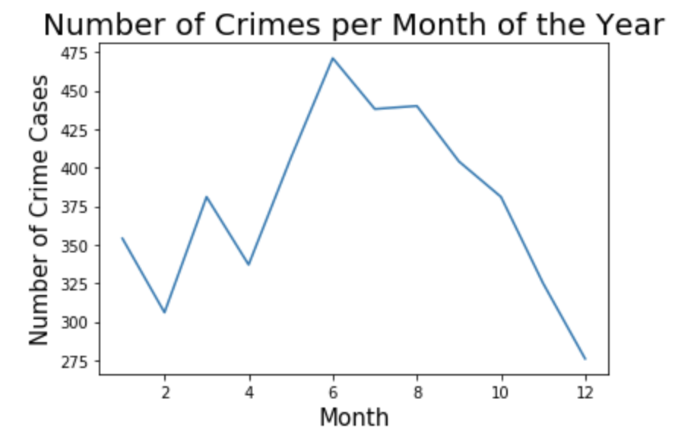
Group number of cases by month and plot

Slide 9
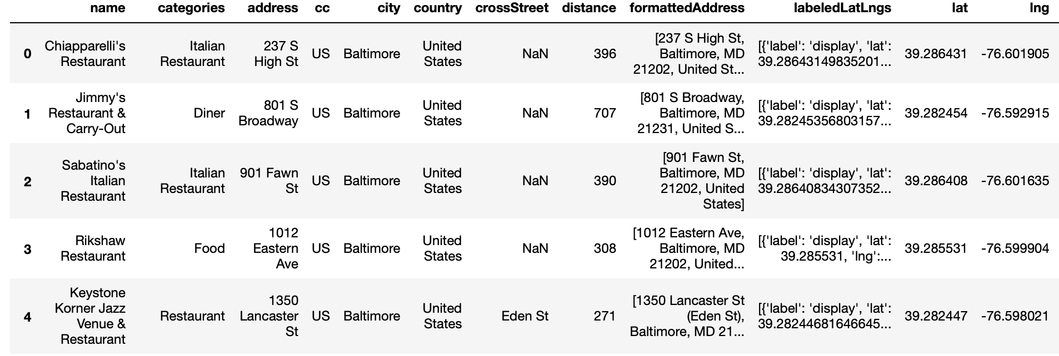
Use FourSquare API to get all restaurant venues around JHU Carey Business School

Slide 10
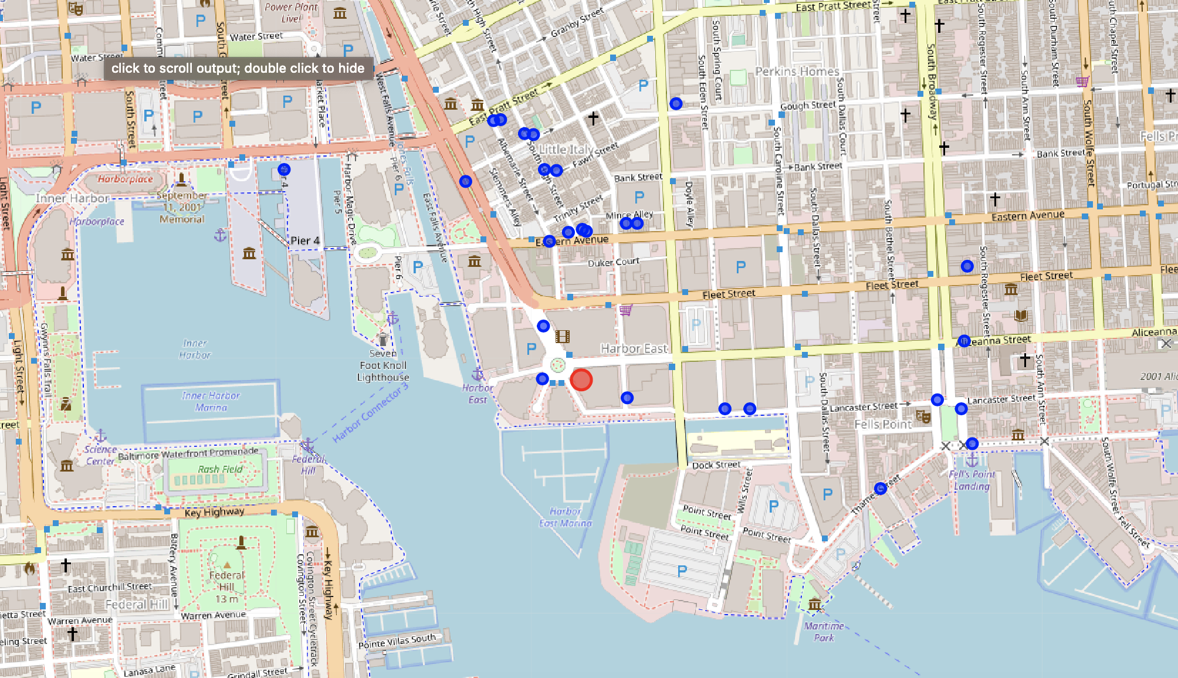
Plot all 25 restaurant venues on the map and their locations. Red circle represents the school location

Slide 11
Conclusion
Inner Harbor ranked number 6 in the most dangerous neighborhoods among all neighborhoods.
The number of cases remained almost flat for the past 6 years, but the number of cases declined drastically in 2020 so far even after extrapolating the number of cases until December.
June, July, and August are three months with most cases, supporting the rationale of proportionally extrapolating the case number in 2020.
There are 25 restaurants near the JHU Carey Business School. However, only few of them are located at the vicinity of the school.

